Slide 1

9238-mangayarkarasi college of engineering
TITTLE:Fake news detection using NLP
Guided by:
Mrs.B.K.Hemalatha HOD/ECE
Prepared by:
G.Sathya
S.I.Syed Ali Fathima
G.Sakthi Priya
K.Porkalai Selvi

Slide 2
Definition :
In summary,the NLP approach ,which can conduct text classification,linguistic features, extraction, sentiment analysis, contextual emotional tone identification,cross –domain/cross-text analysis, and inconsistency analysis between different modalities,has been regarded as an effective technique for fake news detection

Slide 3
Stance detection algorithms
Stance detection algorithms analyze the language used in news articles to determine the author’s perspective on a claim or topic. By comparing it with reliable sources, they can identify potential biases or misinformation. It’s an exciting area of research in NLP
Stance detection algorithms analyze the language used in news articles to figure out if the article supports, opposes, or remains neutral on a particular claim or topic. They compare the article’s language with reliable sources to detect any potential biases or misinformation. It’s like having a fact-checker for news articles! 📰🔍

Slide 4
Important library’s
There are several important libraries for fake news detection using NLP, such as NLTK (Natural Language Toolkit), scikit-learn, and TensorFlow. These libraries provide various tools and algorithms for text processing, feature extraction, and machine learning, which are essential for building effective fake news detection models.
Fake news detection using NLP is spaCy. It is widely used for natural language processing tasks and provides powerful features like tokenization, part-of-speech tagging, and named entity recognition. With spaCy, you can preprocess text data and extract meaningful features to train your fake news detection models. It’s a valuable tool in the NLP toolkit!

Slide 5
Algorithms of fake news detection
Here are some steps for detecting fake news using NLP: 1. Preprocessing: Clean the text by removing punctuation, stop words, and special characters. 2. Tokenization: Split the text into individual words or tokens. 3. Feature Extraction: Extract relevant features from the text, such as word frequencies or n-grams. 4. Model Training: Train a machine learning model, such as a classifier, using labeled data. 5. Evaluation: Assess the performance of the model using metrics like accuracy, precision, recall, and F1 score. 6. Predictions: Use the trained model to make predictions on new, unseen news articles. These steps help in building an NLP-based fake news detection system.

Slide 6
Python code for fake news detection using NLP: ```python import pandas as pd from sklearn.feature_extraction.text import TfidfVectorizer from sklearn.model_selection import train_test_split from sklearn.linear_model import PassiveAggressiveClassifier from sklearn.metrics import accuracy_score # Load the dataset df = pd.read_csv(‘news_dataset.csv’) # Split the dataset into training and testing sets X_train, X_test, y_train, y_test = train_test_split(df[‘text’], df[‘label’], test_size=0.2, random_state=42) # Initialize the TF-IDF vectorizer tfidf_vectorizer = TfidfVectorizer(stop_words=‘english’, max_df=0.7) ``` This code uses the `TfidfVectorizer` to convert the text data into numerical features, and then trains a `PassiveAggressiveClassifier` model on the TF-IDF vectors. Finally, it evaluates the accuracy of the model on the testing data. Remember to replace `’news_dataset.csv’` with the path to your own dataset.

Slide 7
# Fit and transform the training data tfidf_train = tfidf_vectorizer.fit_transform(X_train) # Transform the testing data tfidf_test = tfidf_vectorizer.transform(X_test) # Initialize the Passive Aggressive Classifier pac = PassiveAggressiveClassifier(max_iter=50) pac.fit(tfidf_train, y_train) # Make predictions on the testing data y_pred = pac.predict(tfidf_test) # Calculate accuracy accuracy = accuracy_score(y_test, y_pred) print(“Accuracy:”, accuracy) ``` This code uses the `TfidfVectorizer` to convert the text data into numerical features, and then trains a `PassiveAggressiveClassifier` model on the TF-IDF vectors. Finally, it evaluates the accuracy of the model on the testing data. Remember to replace `’news_dataset.csv’` with the path to your own dataset.

Slide 8
Let’s read tha data into tha data frame and get the shape of the data and first 5 record
#Read the data df=pd.read_csv(‘D:\\DataFlair\\news.csv’) #Get shape and head df.shape df.head()

Slide 9
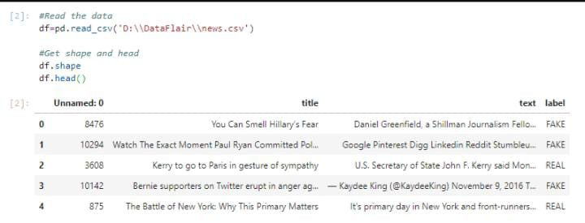
Output

Slide 10
Conclusion for fake news detection
In conclusion, the fake news detection using NLP is a powerful technique that can help identify misleading or false information. By leveraging natural language processing and machine learning algorithms, we can analyze the textual content of news articles and classify them as either real or fake.
This approach, as demonstrated in the code example, utilizes TF-IDF vectorization and the Passive Aggressive Classifier to achieve accurate results. It’s an effective tool in combating the spread of misinformation and promoting reliable news sources. 📰🔍

Slide 11

Thank you

